Slide 1
ME659A Prediction of crater wear Using image processing
Navneet Dwivedi
Ritik Raj
Rahul Joshi

Slide 2
Contents
Purpose
Experimental ​Work
​Wear Patterns Obtained
​Tool Fracture
Processed Data & Images
Future Scope

Slide 3
Purpose?
In machining, high cutting forces, and temperatures cause tool crater wear. The quality of machined parts and tool replacement downtime depend on accurate tool crater wear prediction.
Image processing is an essential tool in predicting tool crater wear in machining operations.
Its accurate and non-destructive analysis of the tool surface optimizes the machining process, reduces downtime, and lowers tool replacement costs.

Slide 4
Experimental Work
Identification of the tool as well as the workpiece for analysis.
Finalizing the appropriate values of different input parameters (feed rate and speed) for machining.
Machining of work-piece using the tool in a CNC machine.
Analyzing and recording the tool wear (both at the nose and flank) using an optical microscope.
Using the Image J software to process the data (images of wear) in the desired format.

Slide 5
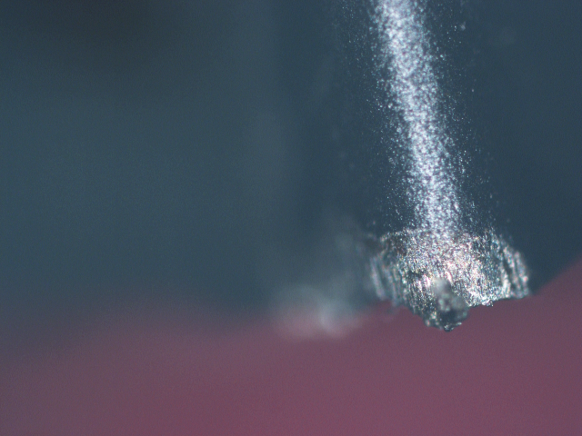
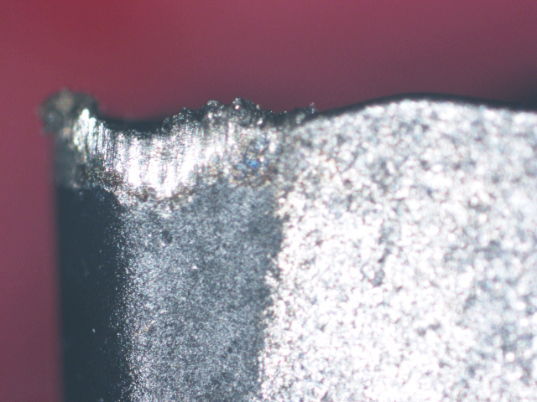
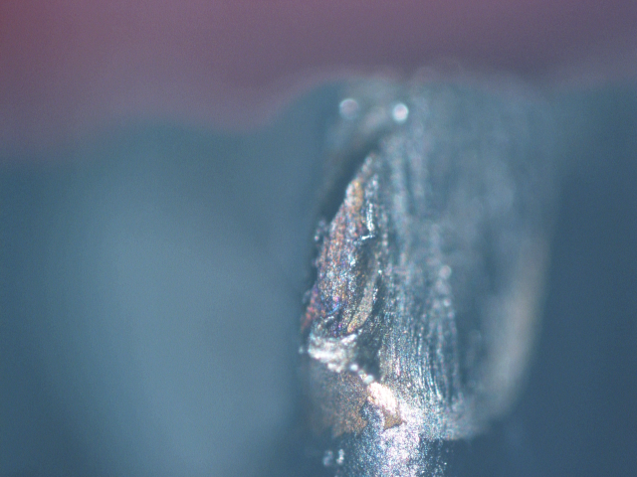
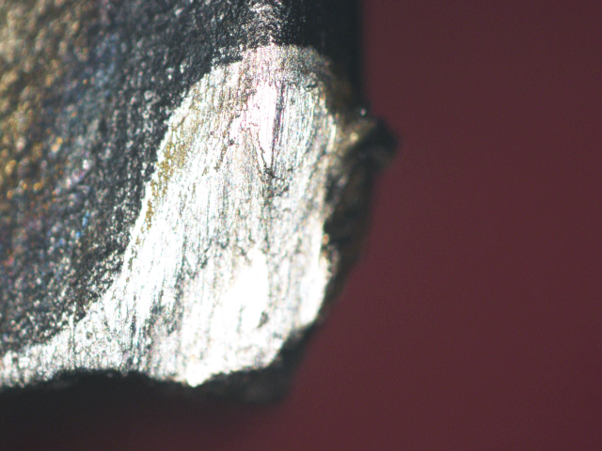
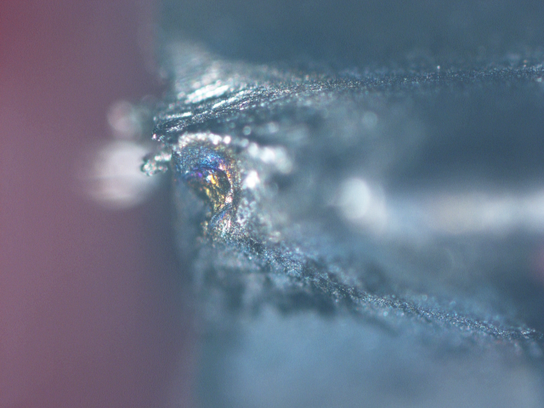
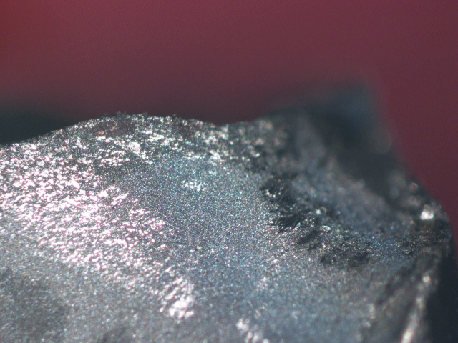
Wear Patterns Obtained
F_10_S_70
F_10_S_70
F_10_S_80
Nose Wear
Tool Wear
Nose Wear
F_10_S_80
F_10_S_90
F_10_S_90
Tool Wear
Nose Wear
Tool Wear

Slide 6
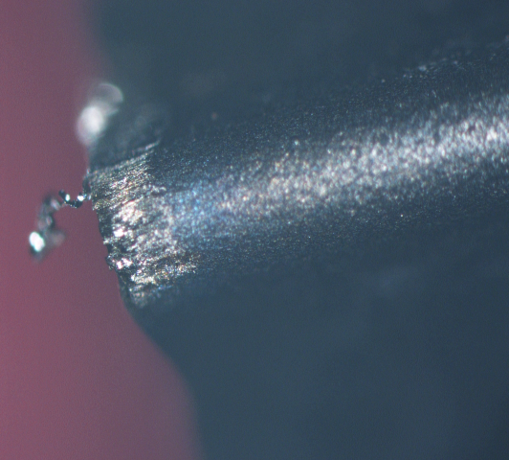
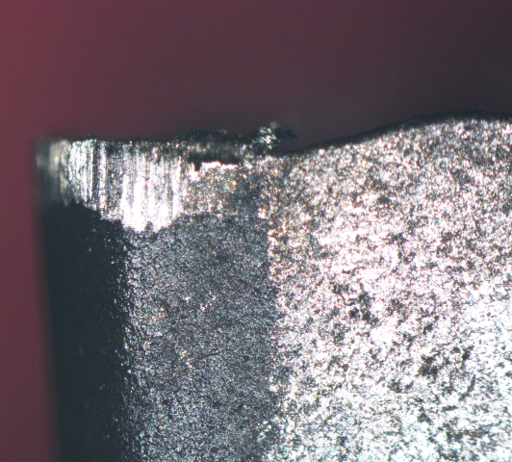
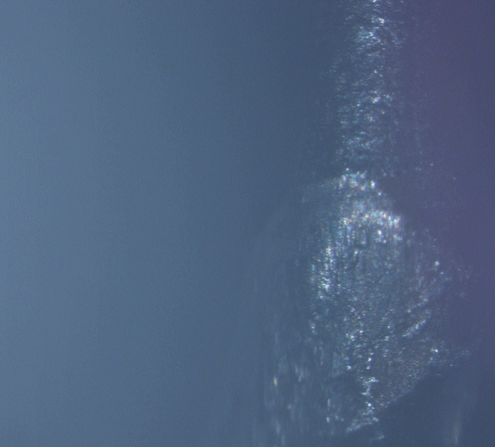
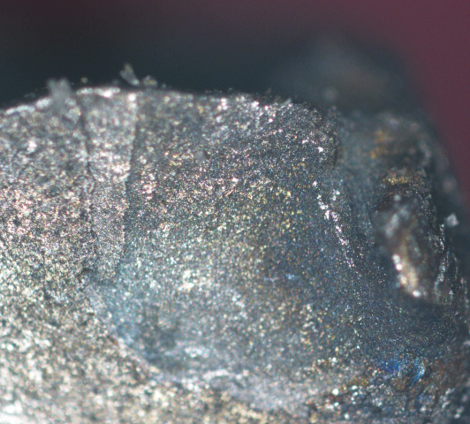
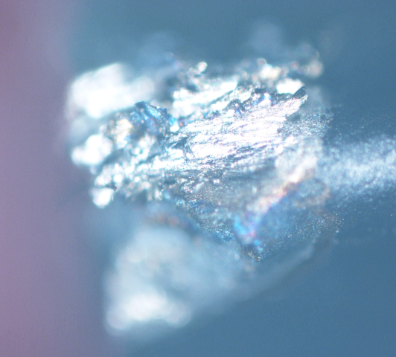
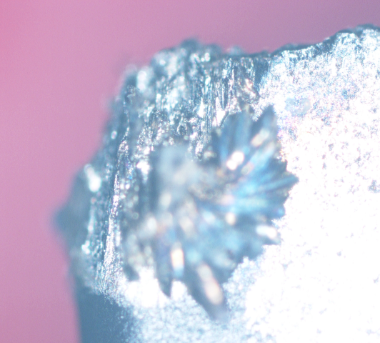
Wear Patterns Obtained
F_15_S_70
F_15_S_70
F_15_S_80
Nose Wear
Tool Wear
Nose Wear
F_15_S_80
F_15_S_90
F_15_S_90
Tool Wear
Nose Wear
Tool Wear

Slide 7
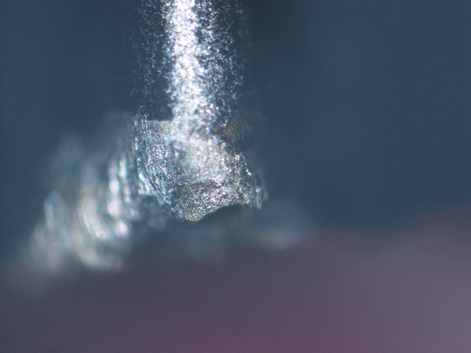
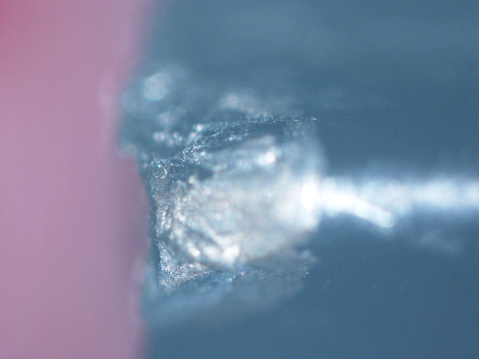
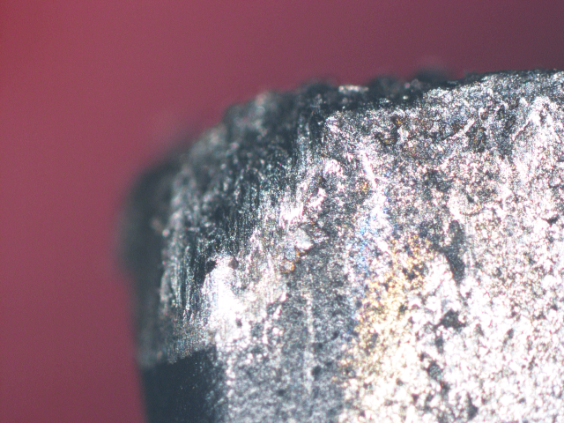
Some More tool wear
F_20_S_80
F_20_S_90
F_20_S_90
​
Nose Wear
Nose Wear
Tool Wear

Slide 8
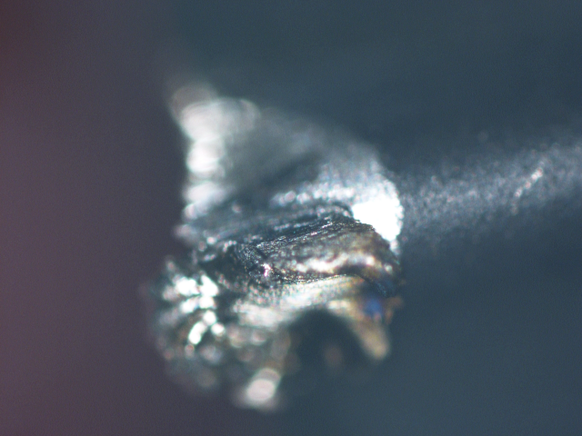
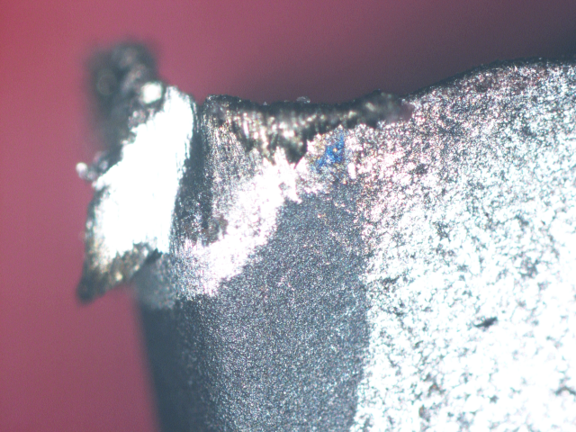
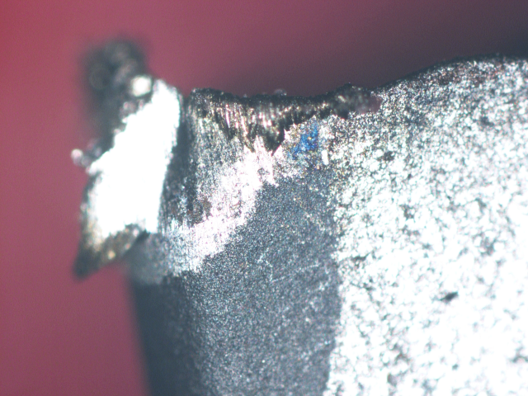
Tool Fracture
F_20_S_70
F_20_S_70
F_20_S_70
​
Nose Wear
Tool Wear - 1
Tool Wear - 2

Slide 9
Images we are using
The results we obtained were decent, but they were not enough to predict the wear patterns.

Slide 10
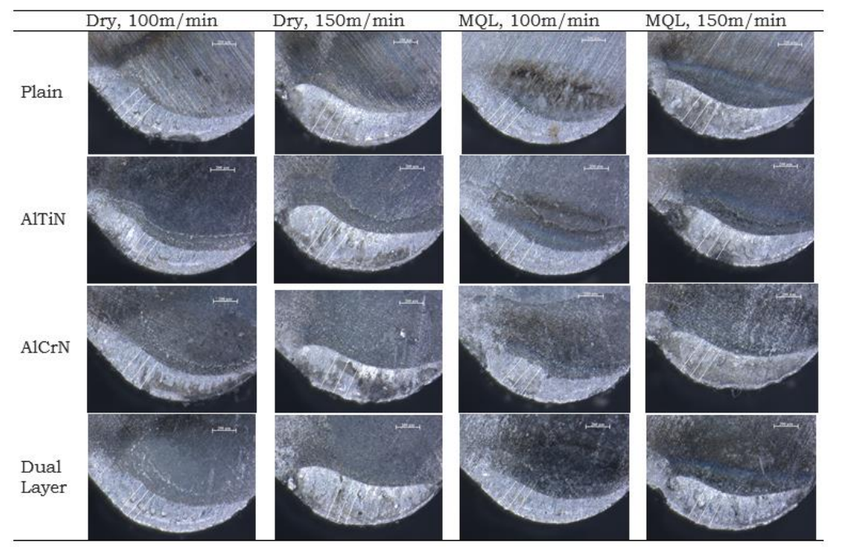
Final Images Used
Software Used: Image J

Slide 11
Image Processing
Image processing is a subfield of computer vision that deals with the analysis, manipulation, and interpretation of images.
Image processing is used to enhance images by removing noise, sharpening edges, adjusting brightness and contrast, and more.

Slide 12
Processed Data
Crater Wear Prediction Through Image Processing/ML
 | S.NO | TOTAL AREA (At) | Mean | Min | Max |  | S.NO | Ellipse AREA (A) | Mean | Min | Max |  | A/A(t) | NEW SQ.
 | 1 | 337437.642 | 164.361 | 37 | 243 |  | 1 | 83718.821 | 168.151 | 52 | 243 |  | 0.248101606 | C
 | 2 | 365850.34 | 174.2 | 49 | 253 |  | 2 | 118775.51 | 182.97 | 96 | 253 |  | 0.324656006 | A
 | 3 | 317188.209 | 168.379 | 46 | 236 |  | 3 | 50408.163 | 173.045 | 111 | 225 |  | 0.158921932 | I
 | 4 | 302789.116 | 160.045 | 36 | 235 |  | 4 | 69659.864 | 161.097 | 96 | 230 |  | 0.23006066 | D
 | 5 | 368480.726 | 162.486 | 23 | 252 |  | 5 | 47120.181 | 168.301 | 108 | 217 |  | 0.127876922 | N
 | 6 | 428752.834 | 169.279 | 26 | 254 |  | 6 | 65034.014 | 174.764 | 100 | 250 |  | 0.151681829 | L
 | 7 | 315147.392 | 171.246 | 31 | 236 |  | 7 | 53877.551 | 177.306 | 136 | 235 |  | 0.17095985 | G
 | 8 | 302653.061 | 159.281 | 48 | 254 |  | 8 | 78412.698 | 155.576 | 57 | 250 |  | 0.259084437 | B
 | 9 | 343922.902 | 153.201 | 41 | 242 |  | 9 | 54421.769 | 149.54 | 91 | 210 |  | 0.158238282 | J
 | 10 | 369206.349 | 152.423 | 33 | 253 |  | 10 | 56916.1 | 158.963 | 66 | 253 |  | 0.154157967 | K
 | 11 | 288639.456 | 166.823 | 36 | 242 |  | 11 | 59954.649 | 169.132 | 88 | 242 |  | 0.207714669 | E
 | 12 | 379138.322 | 149.444 | 35 | 243 |  | 12 | 40680.272 | 145.938 | 100 | 212 |  | 0.10729665 | O
 | 13 | 357460.317 | 171.316 | 41 | 254 |  | 13 | 59682.54 | 174.557 | 110 | 237 |  | 0.166962701 | G
 | 14 | 402766.44 | 167.602 | 66 | 252 |  | 14 | 65351.474 | 176.268 | 70 | 247 |  | 0.162256503 | H
 | 15 | 307074.83 | 167.773 | 31 | 251 |  | 15 | 40702.948 | 172.961 | 85 | 236 |  | 0.132550584 | M
 | 16 | 343197.279 | 154.549 | 43 | 244 |  | 16 | 34965.986 | 161.028 | 59 | 245 |  | 0.101883051 | P
 | SCALE = 0.21 SCALE/PIXEL

Slide 13
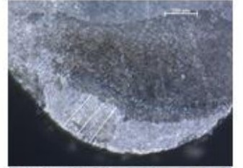
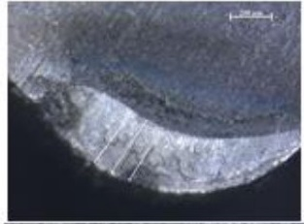
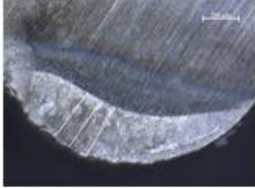
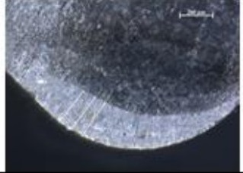
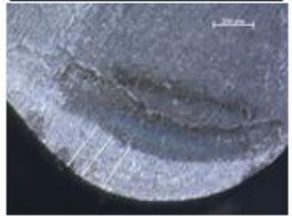
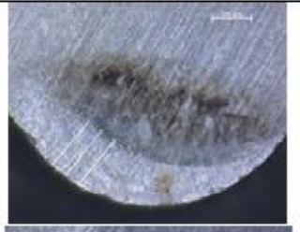
Wear Patterns Obtained
55 m/min
60 m/min
65 m/min
70 m/min
75 m/min
80 m/min

Slide 14
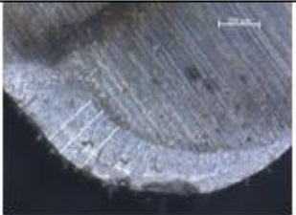
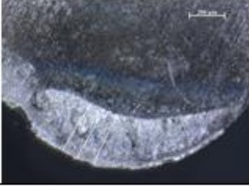
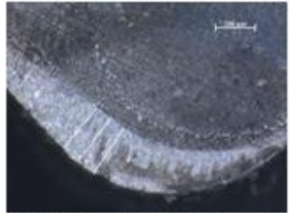
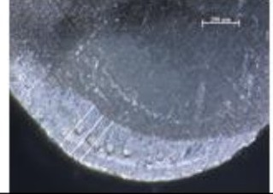
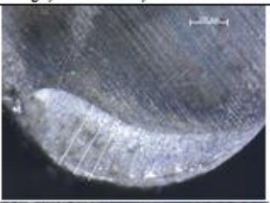
Wear Patterns Obtained
80 m/min
85 m/min
90 m/min
95 m/min
100 m/min
105 m/min

Slide 15
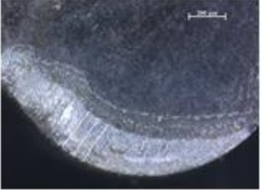
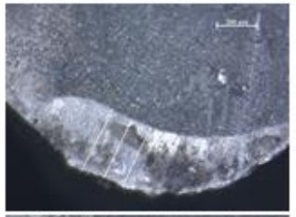
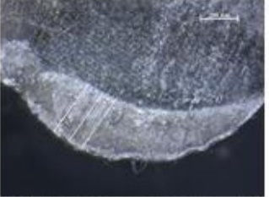
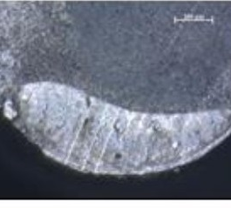
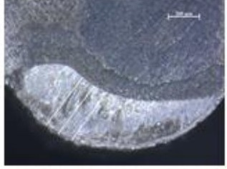
Wear Patterns Obtained
110 m/min
115 m/min
120 m/min
125 m/min
130 m/min

Slide 16
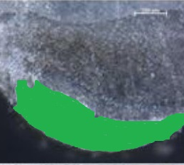
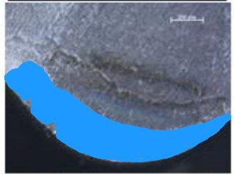
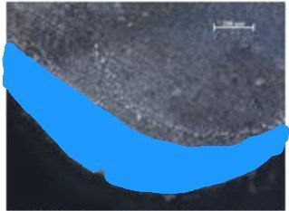
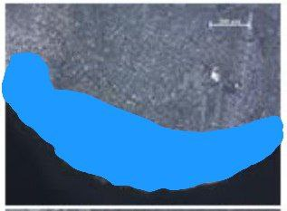
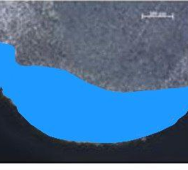
Processed Images
55 m/min
75 m/min
95 m/min
115 m/min
125 m/min

Slide 17
Steps Involved
Segmentation on the input images
Convert the image to grayscale
Calculate a histogram of the grayscale image
Set lower and upper threshold values based on the color used to calculate the difference
Apply binary thresholding to the grayscale image using the lower and upper threshold values
Apply bitwise AND operation between the two thresholded images
Apply median filtering to the resulting image to remove noise

Slide 18
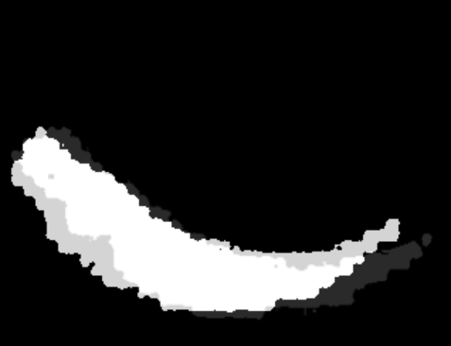
1. The pure white area represents the previous image. 2. The medium part represents the growth that has progressed since then. 3. The lighter part has an area that was not covered in this but is part of the target image, i.e, the upper bound image.
Results
Predicted Shape

Slide 19
1. The pure white area represents the previous image. 2. The medium part represents the growth that has progressed since then. 3. The lighter part has an area that was not covered in this but is part of the target image, i.e, the upper bound image.
Results
Predicted Area

Slide 20
Future Scope
We can generalize this model to perform prediction for much more generic cases if more data is employed.
We can introduce some other parameters which can positively alter its accuracy.
Ensuring enough data can make the model predict the wear for varied machining conditions (Dry or MQL).

Slide 21
References
Moldovan, O. G., Dzitac, S., Moga, I., Vesselenyi, T., & Dzitac, I. (2017, November 30). Tool-Wear Analysis Using Image Processing of the Tool Flank. MDPI. https://doi.org/10.3390/sym9120296
A. (2022, November 3). GitHub - ArashRabbani/Augmented-Pattern: Image augmentation tool for creating new realizations and their labels. GitHub. https://github.com/ArashRabbani/Augmented-Pattern

Slide 22
THANK YOU

